Slide 1
Smart Donation System
By Ankur Vora

Slide 2
Problem
There are many people in our community (or area) who can’t afford to have basic needs (food, clothes, education) due to low income. On the other hand, there are people who have enough resources and wish to donate goods which can be beneficial to others, but are always skeptical if their goods are channeled to the beneficiaries through correct medium.

Slide 3
Proposed Solution
The objective of this project is to create an application where we gather the different needs of the consumers within the community. Donors will donate goods to the community and based on the consumer's demand, goods gets distributed to the beneficiary. Here we are bridging the gap between donor and beneficiary by creating an application to ease the complete process. This way, the donated goods are efficiently managed and distributed effectively within the community.

Slide 4
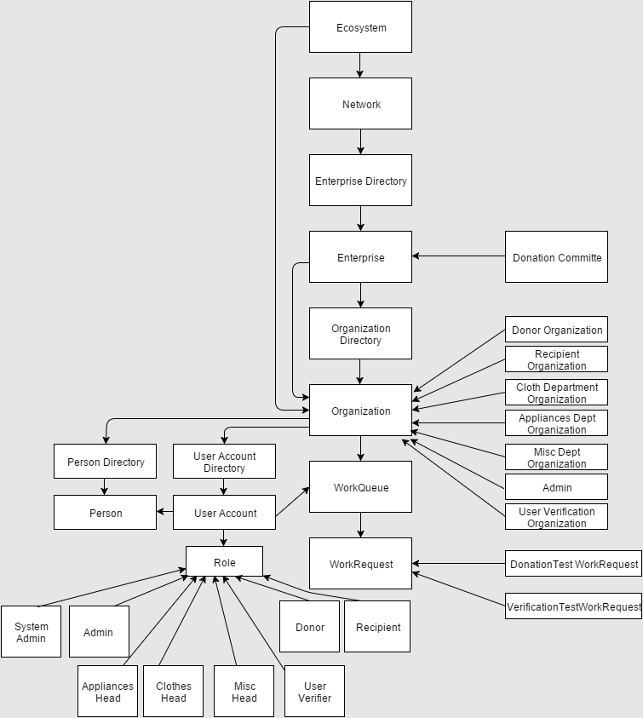
Object Model

Slide 5
Key Roles
Donor: Enter the items he/she wants to donate.
Recipient/Beneficiary: Requests the list of items he/she needs.
Admin: Administrate all the departments and complete flow.
Appliances Department Head: Monitors different food items donated by donors and distributes according to needs.
Clothes Department Head: Monitors different clothes donated by donors, segregate them and distributes according to needs.
Miscellaneous Department Head: Monitors other items donated by donors and distributes according to needs.
User Verification Person: Accepts the user verification request from respective department, verifies the recipient/beneficiary and give back the remarks to department head.

Slide 6
Key Features
Donor can donate different items as per their choice.
Recipient/ Beneficiary can request for the item they need.
Based on the request, respective head of the department will distribute the donated item to genuine beneficiary who needs it the most.
From on the donation history, we can find out the most popular donor and can be contacted in case of an urgent requirement.

Slide 7
Extra Features
Donor can keep track of the items he/she donated and also can see the Recipient’s name.
Apart from the donated items from donor, Recipient/ Beneficiary can raise a request as per their need. (For Example: Medical help, Education Funding etc.)
Donor can see their nearby requirements and can support them if he/she wishes.
Whenever some new requirement has been posted, all the donors nearby will be notified as a part of IOT.
Pie chart is getting generated whenever required and it is getting saved in the form of an image, which can be used for analysis of donation items.

Slide 8
Thank You

